Slide 1

Introduction to R & Tidyverse

Slide 2
About your host
My name is Manos Antoniou
I'm the co-organizer of PyData Piraeus meetup, which sponsors this workshop
I'm currently working as a data scientist at SoftOne Technologies (https://www.softone.gr/ ), one of the top Greek software companies, focusing in the development of ERP, CRM and innovative Cloud Services
I have a Bsc in Applied Statistics & Computing & Msc in Business Analytics
e-mail: antoniouma@gmail.com

Slide 3
PyData Piraeus
Created on August 2019 & is a part of the global PyData network
The PyData Piraeus community gathers each month discuss how best to apply open-source computer programming tools, like Python, Julia and R, to meet evolving challenges in data management, processing, analytics and visualization.
Meetup page https://www.meetup.com/PyData-Piraeus/ where you can join and get notifications for future events.

Slide 4
R programming language
R is an open source programming language & environment for statistical computing and graphics, initially released in 1997
Is an implementation of S language
It is developed by Ross Ihaka & Robert Gentleman
It is maintained by R development core team
R provides a default GUI, but RStudio IDE should be your default choice

Slide 5
Why R?
There is a very active and diverse community behind R. There are > 15.000 packages on CRAN (package repository for r programming language) that help you accomplish your tasks in a variety of domains
Free and open source
Run on Windows/ Mac/ Linux
Integration with other languages
Great extensibility
Suitable for various tasks like Machine learning, Data analysis, Data Visualization, Statistical analysis, High performance computing
Typical users are Data scientists, Data analysts, Statisticians

Slide 6
Tidyverse
Basically is a collection of modern R packages that share common philosophies, embed best practices, and are designed to work together
Tidyverse packages are optimized to run fast, relying on C++ under the hood, maintained by paid staff of top developers/data scientists (of RStudio) & very well documented
tidyverse package is an R package that serves as a short cut for installing and loading the tidyverse packages (ggplot2, dplyr, tidyr, readr, stringr, forcats, purr, tibble)
Utilizes pipes (%>%) to provide a logical framework for chaining together common data wrangling tasks

Slide 7

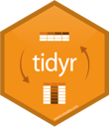

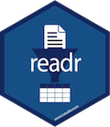

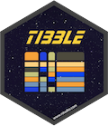

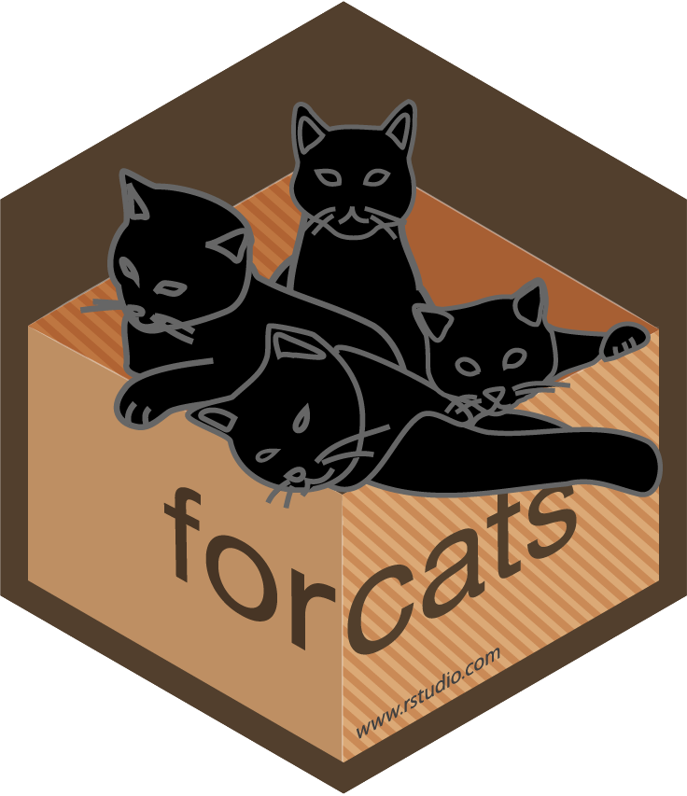
Tidyverse core packages
Provides functions for data manipulation
Help you create tidy data
Every column is variable
Every row is an observation
Every cell is a single value
Create plots and complicated graphics
Provides a fast and friendly way to read rectangular data (e.g. csv, tsv)
Is a modern replacement of the data frames in R
Enhances R’s functional programming toolkit
Provide functions designed to make working with strings as easy as possible.
Provides tools that solve common problems with factors.

Slide 8
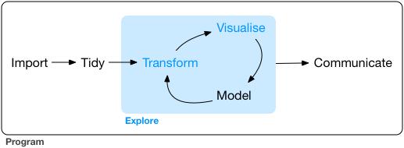
Why Tidyverse?
Tidyverse workflow
Faster data transformation and exploration, because of common data structures & optimized packages
Fast data processing
Clean code

Slide 9
Workshop Schedule
1st PART - Introduction to R & Tidyverse (~ 1 hour)
Introduction to R
Training in tidyverse libraries (dplyr, tidyr, ggplot2, readr, purr, tibble, stringr, forcats)
Data wrangling
Tidy data
Grouping & summarizing
Visualize data
Modelling
2nd PART - Customer segmentation case study
ETL
Exploratory analysis
Modelling
Visualization
3rd PART - Churn prediction case study
ETL
Exploratory analysis
Modelling
Visualization
The total duration of the workshop will be around 2 hours & 45 min.
Deliverables: R notebooks containing all code generated during the 3 parts of the workshop & presentations are uploaded at github link

Slide 10
Questions
You can sent your questions via messaging & I’ll try to answer these at some point during the workshop.
If I can’t answer a question during the workshop, I’ll try my best to include an answer in the github repository in the next couple of days.

Slide 11
Useful resources
Download R (https://cran.r-project.org/ )
Download RStudio IDE (https://rstudio.com/products/rstudio/)
Rstudio cheatsheets (https://rstudio.com/resources/cheatsheets/)
Github repository for today’s workshop (https://github.com/mantoniou/Workshop_R_Tidyverse)
Data science book online (https://r4ds.had.co.nz/)
News about R: Use #rstats in Twitter and https://www.r-bloggers.com/
Tidyverse site https://www.tidyverse.org/

